Slide 1

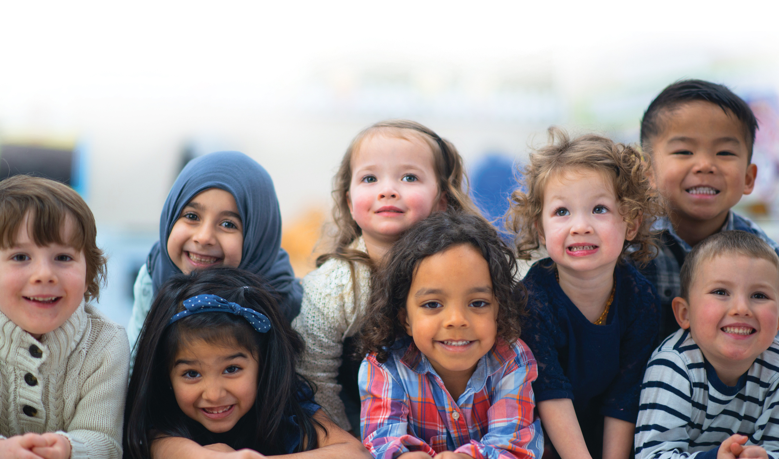

Welcome to Kindergarten and to our Catholic School Community
Brant Haldimand Norfolk Catholic District School Board

Slide 2
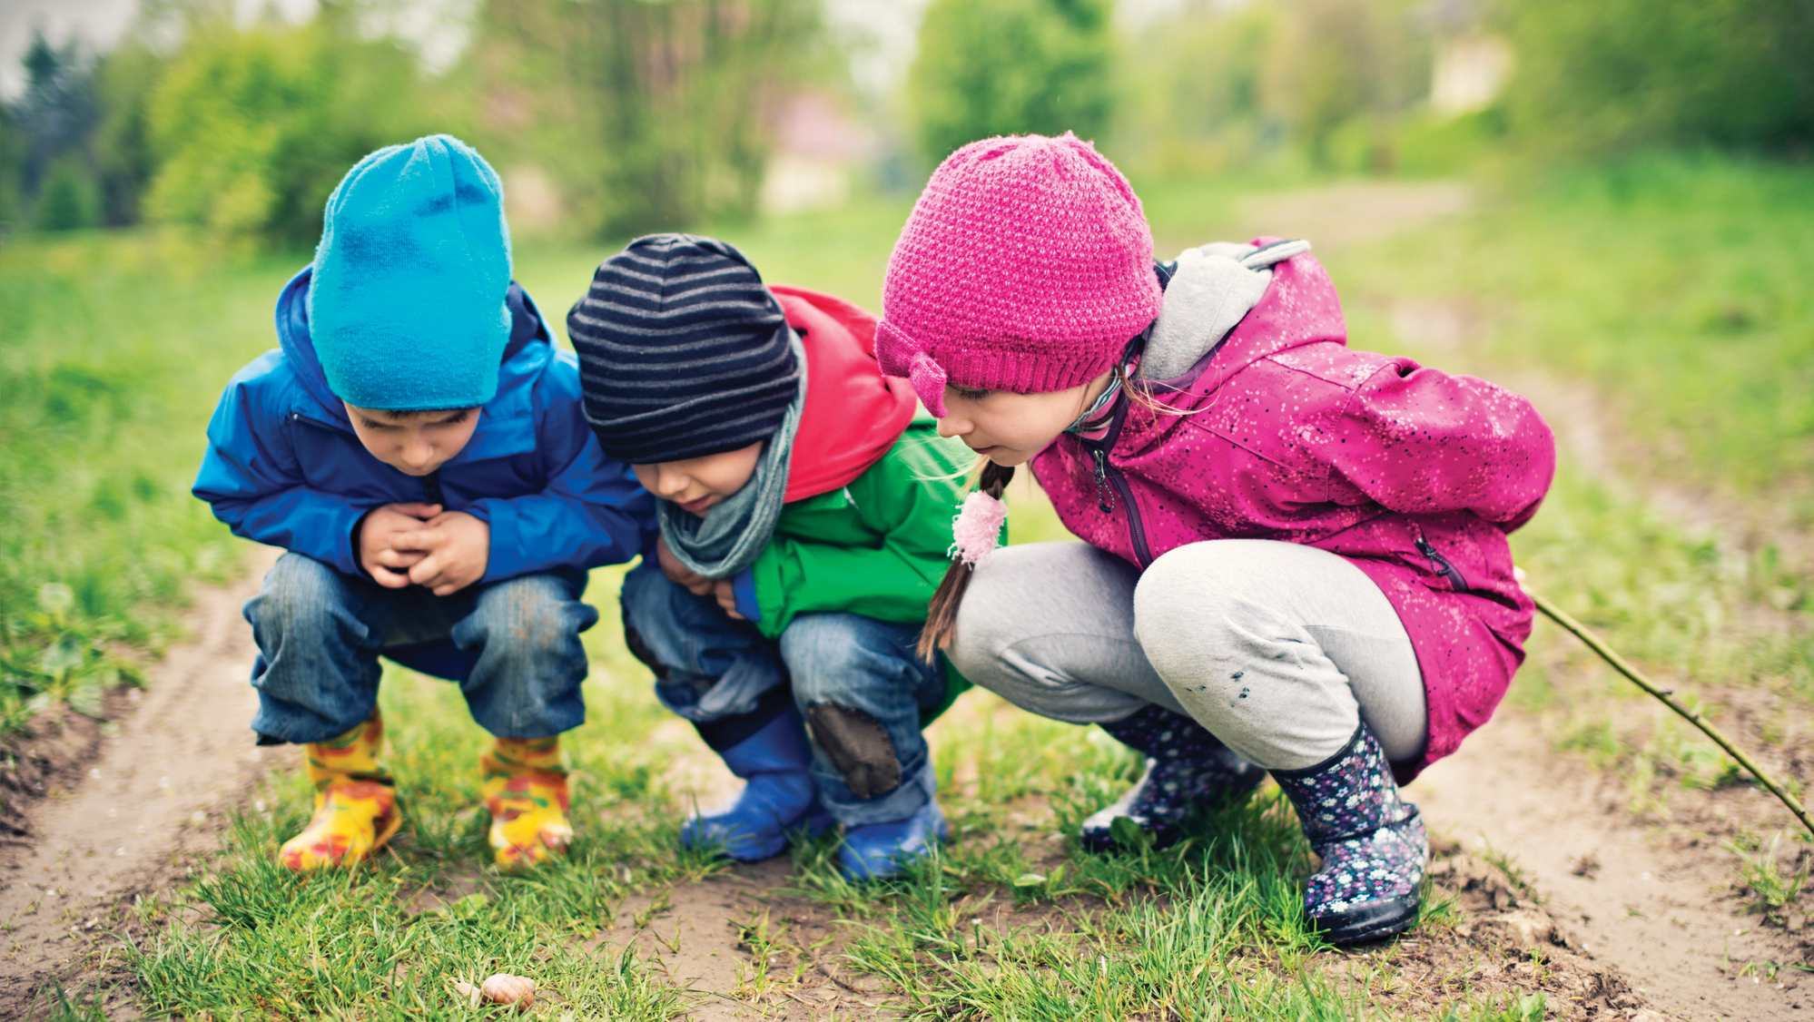
Let the Journey Begin
The Brant Haldimand Norfolk Catholic District School Board offers an engaging, play-based Kindergarten program in a safe, caring and inclusive environment. The program is designed to nurture the development of the mind, body and spirit.

Slide 3


Land Acknowledgement

Slide 4
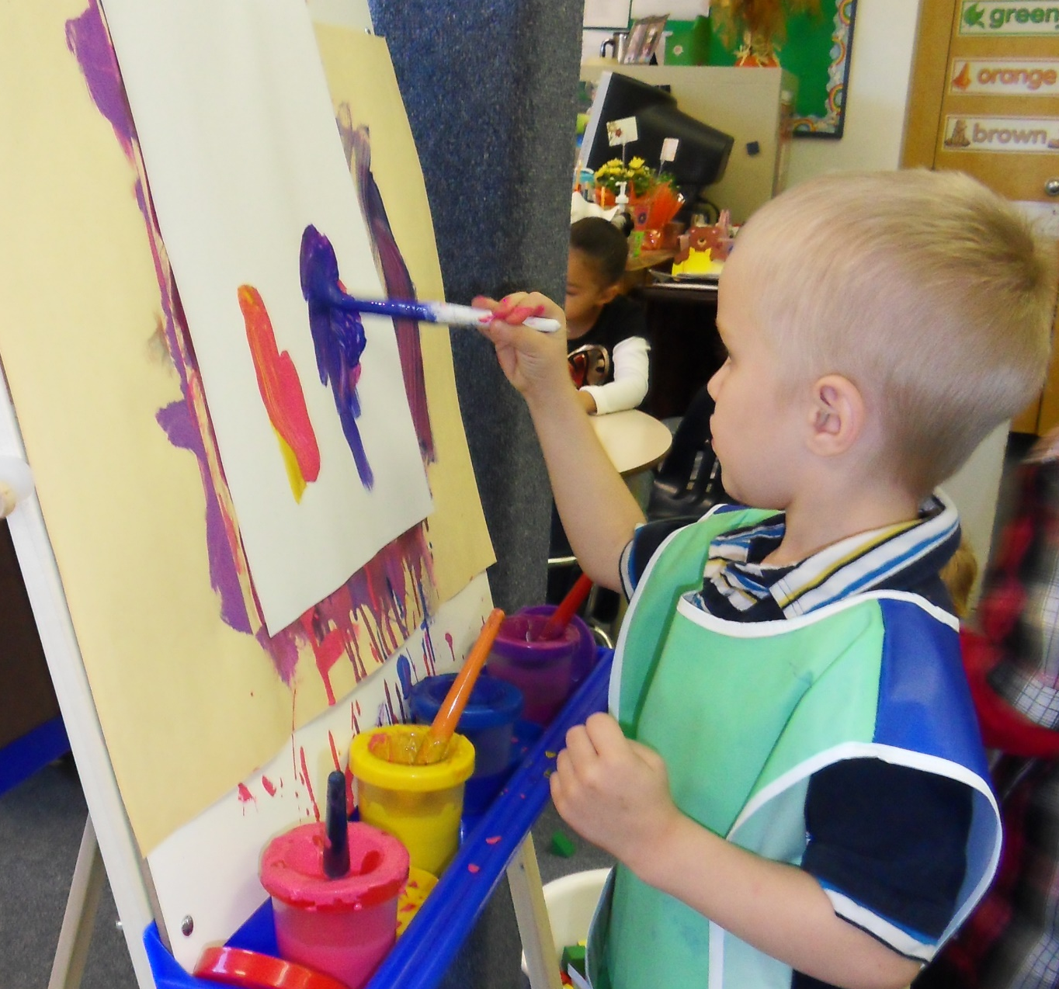
View of Children
All children are competent, capable of complex thinking, curious, and rich in potential and experience.
-The Kindergarten Program
All students can succeed. Each student has his or her own unique patterns of learning.
-Learning for All

Slide 5

Spiritual Development and Learning
A child’s faith journey in school includes various experiences:
learning different forms of prayer including Christian meditation
participating in school liturgies
exploring the wonders of God’s creations
“Let the little children come to me, and do not hinder them, for the kingdom of heaven belongs to such as these.” (Matthew 19:14)

Slide 6

Families are composed of individuals who are competent and capable, curious, and rich in experience. Families love their children and want the best for them. Families are experts on their children. They are the first and most powerful influence on children's learning, development, health, and well-being.
-
We Are Partners in Your Child's Education

Slide 7
Why is Self-Regulation important?
Self-Regulation lays the foundation for how we adjust our feelings, actions and thoughts so we can handle difficult situations, so we don’t get overwhelmed.
Self-Regulation includes recognizing what calm feels like and what it feels like to become overstressed.
The ultimate Self-Regulation goal is to help children understand when and how to manage stress.
As parents/caregivers/families:
it is important to be aware of your own stress, how it affects you and, in turn your children.
you will be most able to build your child’s self-regulation if you take care of your own.

Slide 8
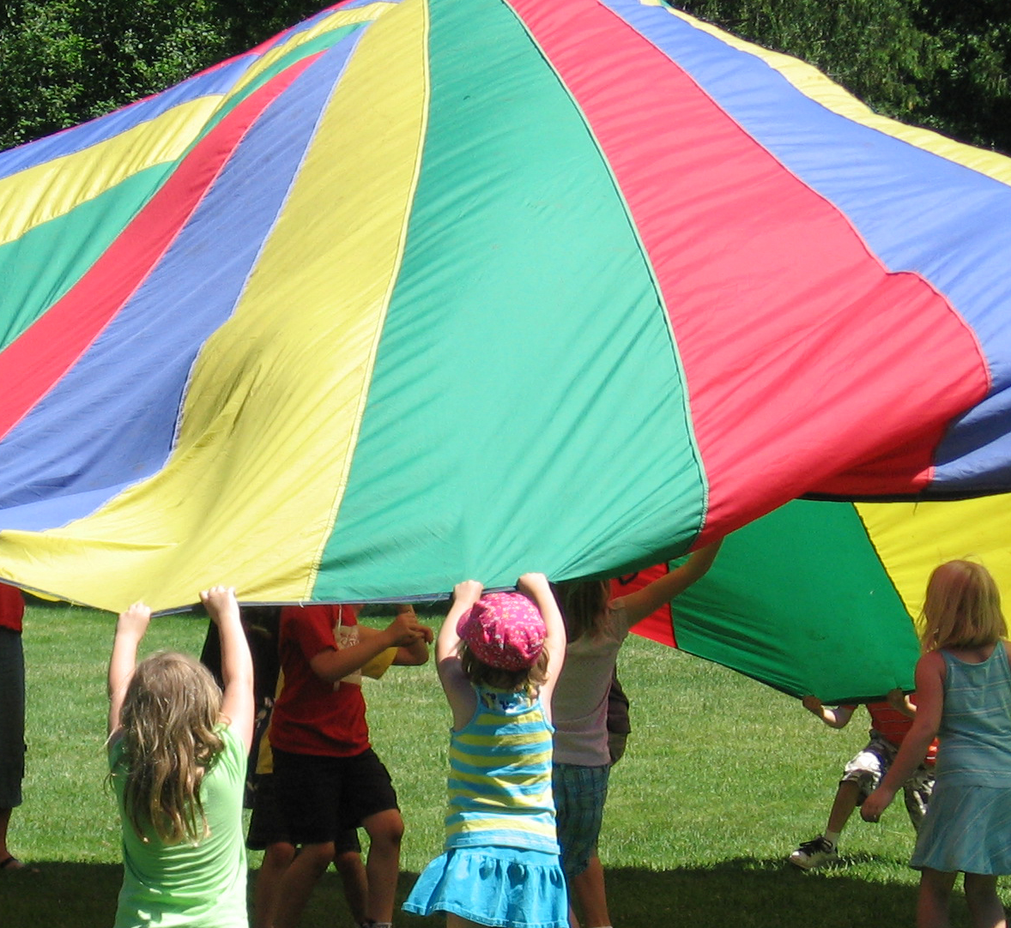
Learning Through Play
Children learn through purposeful play and inquiry in the classroom and outdoors. They learn about themselves, others, and the world around them by exploring, discovering, experimenting, and questioning.
“…for children, play is serious learning. Play is really the work of childhood.” -Fred Rogers

Slide 9
Four Strands
In Kindergarten, your child will build their skills, knowledge, and experiences in four key areas or strands of learning.
Belonging and Contributing: building relationships, identity, and community.
Self-Regulation and Well-Being: supporting physical activity, emotions, and healthy routines.
Foundations of Language and Mathematics: strengthening early literacy and number sense.
Problem Solving and Innovating: building creativity, curiosity, and early STEM habits.
Together, these strands ensure Kindergarten is about the whole child: learning, well-being, and growth.
In Kindergarten, your child will build their skills, knowledge, and experiences in four key areas or strands of learning.
The strands reflect the natural way children learn and help educators and families focus on how a child’s learning develops.

Slide 10
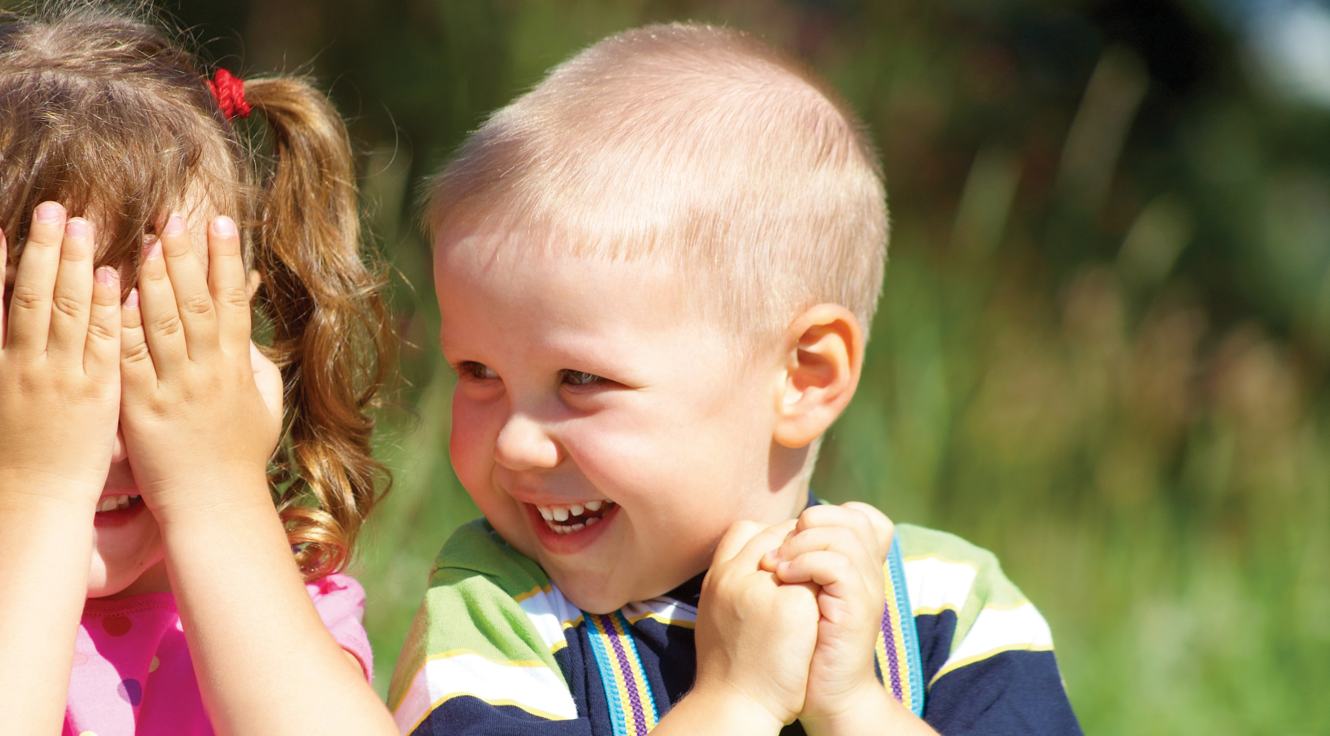
STRAND - Belonging and Contributing
Children explore and learn through their connections to others and roles as community members. Through play and interactions with peers, they learn about relationships as they build an understanding of the contributions they can make to various groups, the wider community and the world around them.

Slide 11

STRAND - Self-Regulation and Well-Being
Children develop a sense of self-awareness and an understanding of the importance of physical and mental health and wellness. They learn important life skills including how to regulate their emotions and how to adapt to distractions.

Slide 12
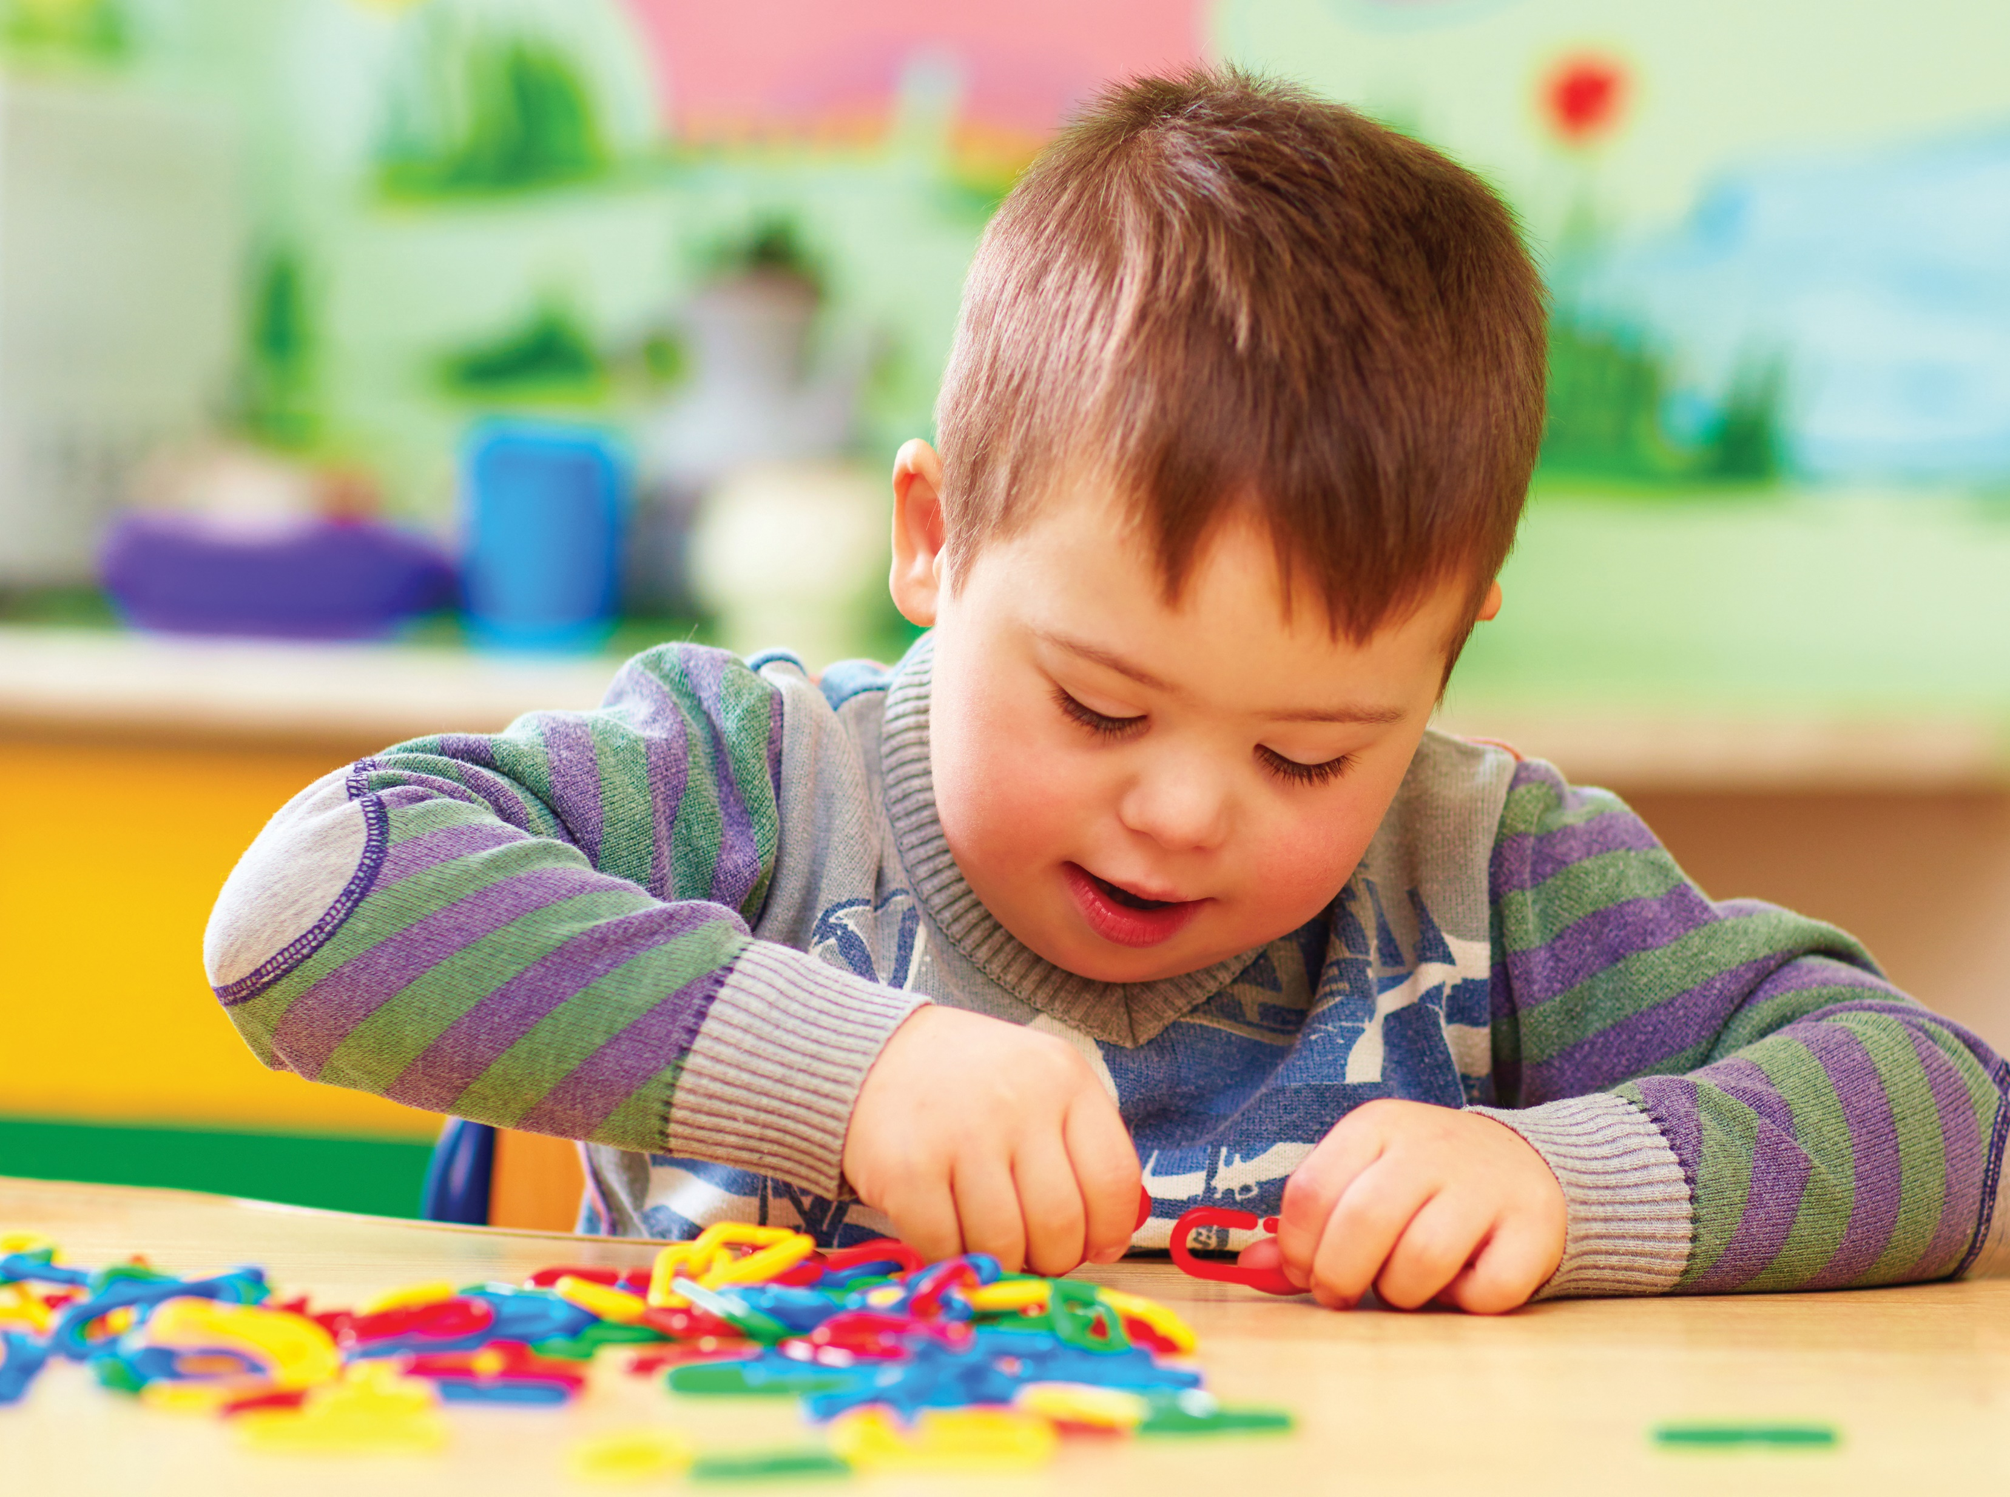
STRAND – Foundations of Language and Mathematics
Children think critically about the world around them and communicate their learning in different ways. They use language and materials to express ideas and emotions and develop reading and writing skills. Using numbers and patterns in play strengthens their growing mathematical skills.

Slide 13

STRAND - Problem Solving and Innovating
Children make meaning of the world around them by observing, questioning, planning, exploring, testing theories, and solving problems. They use their natural curiosity to investigate new and complex ideas.

Slide 14
The Kindergarten Team
* The Kindergarten team is required of classrooms of 16 or more children
Teachers and Early Childhood Educators work together to plan and implement the program and to maintain a healthy physical, emotional, and social learning environment.
Together they :
• interact with each child every day to create a program based on your child’s interests
• create a sense of belonging
• support their social and emotional needs and academic growth

Slide 15

Outdoor Play
Benefits of outdoor play include the development of:
Gross motor skills
Coordination
Physical fitness
Self-regulation skills
Social and emotional skills
Literacy skills
Numeracy skills and many more…..
And most of all it allows time to connect with nature while having fun!
Arrive dressed for all weather conditions to fully engage in daily outdoor play!

Slide 16
Speech and Language
Your child is busy talking, exploring and playing.
All these skills are important for learning communication.
By age Four
Your child should follow a 3-step instruction
Follow directions involving 3 or more steps
Tell stories with a clear beginning middle and end
Able to say simple rhymes
Is understood by strangers

Slide 17


Brant Haldimand Norfolk Preschool Speech and Language System
Smart Start Hub at Lansdowne Children's
Centre519 753 3153 ext. 507 or
www.lansdownecentre.ca
Referrals for children entering school
must be received by March 31st of their
school entry year in order to receive
service. Referrals received between
April 1 and May 31 will receive a speech
language screening. No referrals can be
accepted after May 31st of a child's
school entry year.

Slide 18


Notes:
Andrea
This is a slide for vision that you`ll find in the power point.
Yearly OHIP exams for children with paricipating eye doctors, receive a complimentary pair of eye glasses.

Slide 19

Screen Time
Limit screen time
• Under 2 years old: No screen
• 2 to 5 years old: Less than
1 hour per day
Notes:
This is a new slide. It includes a poster about screen time from the Canadian Peadiatric Society.
Let us be mindful about the intent of screen use and how long our children/students are spending on screens while at home and at school. Screen time includes all blue screens, such as computer, smart board, TV, Phone, Tablet, iPad, etc.

Slide 20
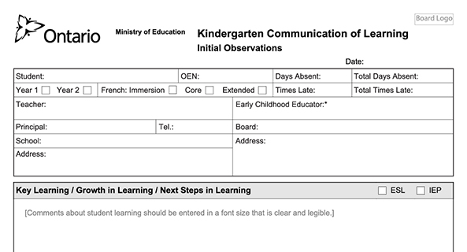
How Learning is Communicated
Examples of educator communications to families include:
Conversations through phone calls
Conversations in person
Email
Written notes
Digital portfolio entries
Kindergarten Communication of Learning reports (fall, winter, late spring)
“Ongoing, clear and meaningful communication between parents, their child, and the educator team is vital to a child’s growth in learning.”
-Understanding Your Child’s Reports

Slide 21

Thank you for choosing Catholic Education and welcome to our Catholic School Community.
If you have questions or for more information, visit www.CatholicEducation.ca or connect with your school principal.

